Slide 1
Regression Analysis
Other Regression Methods
Nicoleta Serban, Ph.D.
Associate Professor
Stewart School of Industrial and Systems Engineering
Robust Regression

Slide 2
About this lesson

Slide 3
Multiple Linear Regression
Data: {(x₁₁,.., x_{1p}),Y₁},….,{(x_{n1},.., x_{np} ),Y_{n}}
Model: Y_{i} = β₀ + β₁x_{i1} + β₂x_{i2} +…+ β_{p}x_{ip} + ε_{i}, i =1,…,n
What if there are outliers?
If one or two, remove the outliers and fit again ⇒ Compare models with and without outliers
If many, it is an indication that the normality assumption does not hold ⇒ Use an approach that provider robust estimates to outliers
Assumptions:
Linearity/Mean Zero Assumption: E(ε_{i}) = 0
Constant Variance Assumption: Var(ε_{i}) = σ²
Independence Assumption: {ε₁,…, ε_{n}} are independent random variables
Normality Assumption: ε_{i} ~ Normal

Slide 4
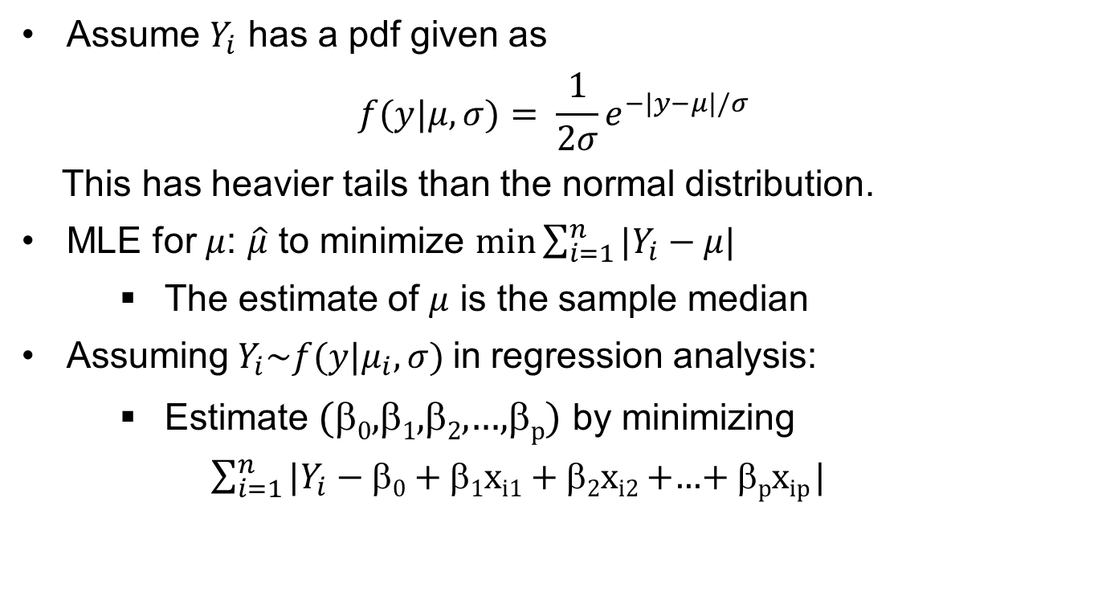
Example: Departure from Normality
Assume $Y_{i}$ has a pdf given as
$$f(y|μ,σ)= \frac{1}{2σ}e^{−|y−μ|/σ}$$
This has heavier tails than the normal distribution.
MLE for $μ$: $\hat{μ}$ to minimize $\min{\sum_{i=1}^{n}{|Y_{i}−}}$ $μ$|
  The estimate of $μ$ is the sample median
Assuming${ Y}_{i}\sim f(y|μ_{i},σ)$in regression analysis:
  Estimate (β₀,β₁,β₂,…,β_{p}) by minimizing
  ${\sum_{i=1}^{n}{|Y_{i}−}}$ β₀ + β₁x_{i1} + β₂x_{i2} +…+ β_{p}x_{ip} |

Slide 5
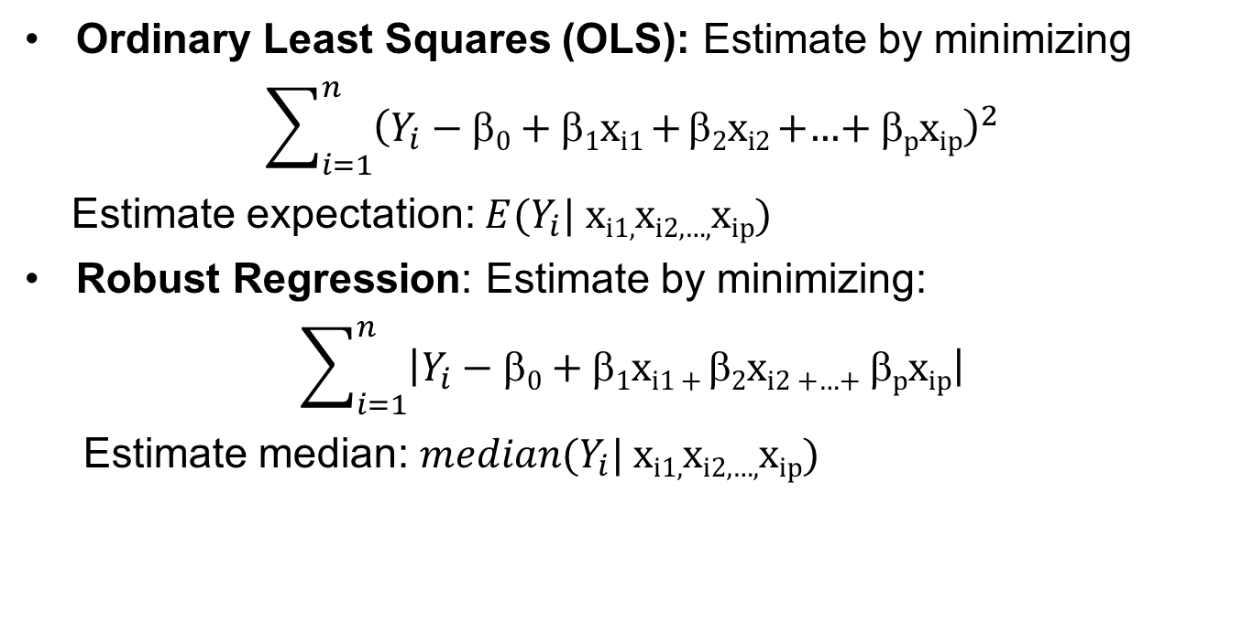
OLS vs Robust Regression
Ordinary Least Squares (OLS): Estimate by minimizing
$$\sum_{i=1}^{n}{{\left(Y_{i}−\text{b}\text{0} \text{+} \text{b}\text{1}\text{x}\text{i}\text{1} \text{+} \text{b}\text{2}\text{x}\text{i}\text{2} \text{+…+} \text{b}\text{p}\text{x}\text{ip}\right)}^{2}}$$
Estimate expectation: ${E(Y}_{i}|$ $\text{x}\text{i}\text{1,}\text{x}\text{i}\text{2,…,}\text{x}\text{ip}$)
Robust Regression: Estimate by minimizing:
$$\sum_{i=1}^{n}{\left|Y_{i}−\text{b}\text{0} \text{+} \text{b}\text{1}\text{x}\text{i}\text{1 + }\text{b}\text{2}\text{x}\text{i}\text{2 +…+ }\text{b}\text{p}\text{x}\text{ip}\right|}$$
Estimate median: ${median(Y}_{i}|$ $\text{x}\text{i}\text{1,}\text{x}\text{i}\text{2,…,}\text{x}\text{ip}$)

Slide 6
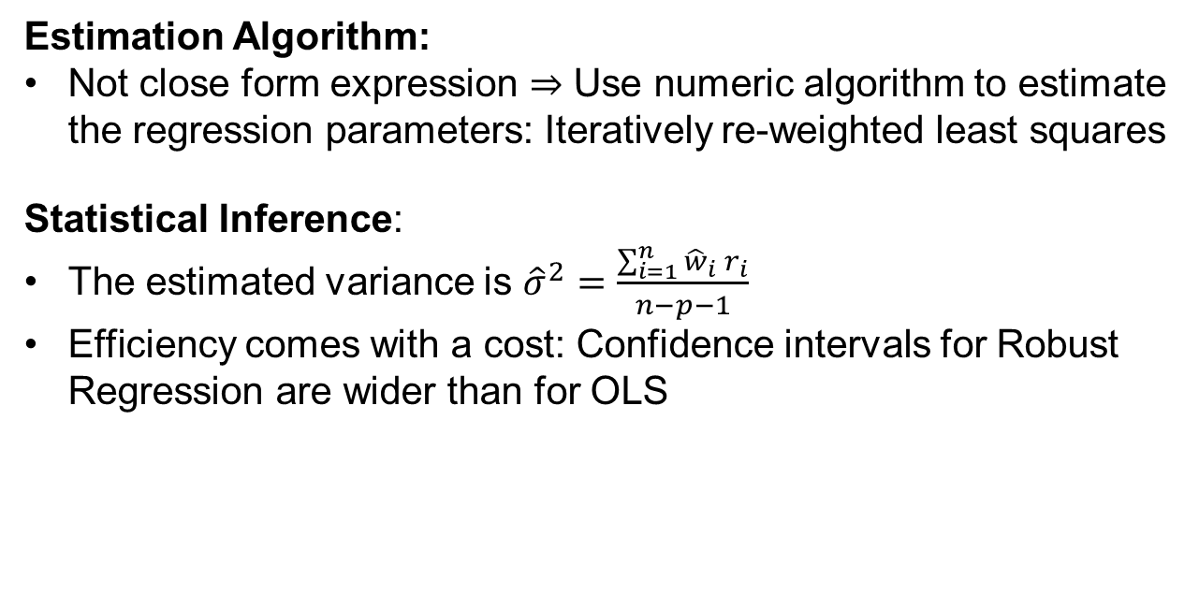
Why not always use Robust Regression?
Estimation Algorithm:
Not close form expression ⇒ Use numeric algorithm to estimate the regression parameters: Iteratively re-weighted least squares
Statistical Inference:
The estimated variance is ${\hat{σ}}^{2}=\frac{\sum_{i=1}^{n}{{\hat{w}}_{i} r_{i}}}{n−p−1}$
Efficiency comes with a cost: Confidence intervals for Robust Regression are wider than for OLS
Notes:
Why n-p-1? Examination question.

Slide 7
Summary

